Slide 1
Chapter 2 - Introduction to C Programming
Outline
2.1 Introduction
2.2 A Simple C Program: Printing a Line of Text
2.3 Another Simple C Program: Adding Two Integers
2.4 Memory Concepts
2.5 Arithmetic in C
2.6 Decision Making: Equality and Relational Operators

Slide 2
Objectives
In this chapter, you will learn:
  To be able to write simple computer programs in C.
  To be able to use simple input and output statements.
  To become familiar with fundamental data types.
  To understand computer memory concepts.
  To be able to use arithmetic operators.
  To understand the precedence of arithmetic operators.
  To be able to write simple decision making statements.

Slide 3
2.1 Introduction
C programming language
  Structured and disciplined approach to program design
Structured programming
  Introduced in chapters 3 and 4
  Used throughout the remainder of the book

Slide 4
2.2 A Simple C Program:
Printing a Line of Text
1 /* Fig. 2.1: fig02_01.c
2 A first program in C */
3 #include <stdio.h>
4
5 /* function main begins program execution */
6 int main()
7 {
8 printf( "Welcome to C!\n" );
9
10 return 0; /* indicate that program ended successfully */
11
12 } /* end function main */
Welcome to C!
Comments
  Text surrounded by /* and */ is ignored by computer
  Used to describe program
#include <stdio.h>
  Preprocessor directive
    Tells computer to load contents of a certain file
  <stdio.h> allows standard input/output operations

Slide 5
2.2 A Simple C Program:
Printing a Line of Text
int main()
  C++ programs contain one or more functions, exactly one of which must be main
  Parenthesis used to indicate a function
  int means that main "returns" an integer value
  Braces ({ and }) indicate a block
    The bodies of all functions must be contained in braces

Slide 6
2.2 A Simple C Program:
Printing a Line of Text
printf( "Welcome to C!\n" );
  Instructs computer to perform an action
    Specifically, prints the string of characters within quotes (" ")
  Entire line called a statement
    All statements must end with a semicolon (;)
  Escape character (\)
    Indicates that printf should do something out of the ordinary
    \n is the newline character

Slide 7
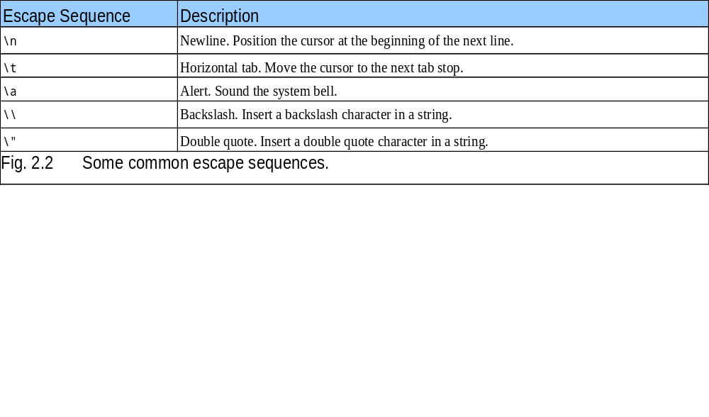
2.2 A Simple C Program:
Printing a Line of Text

Slide 8
2.2 A Simple C Program:
Printing a Line of Text
return 0;
  A way to exit a function
  return 0, in this case, means that the program terminated normally
Right brace }
  Indicates end of main has been reached
Linker
  When a function is called, linker locates it in the library
  Inserts it into object program
  If function name is misspelled, the linker will produce an error because it will not be able to find function in the library

Slide 9
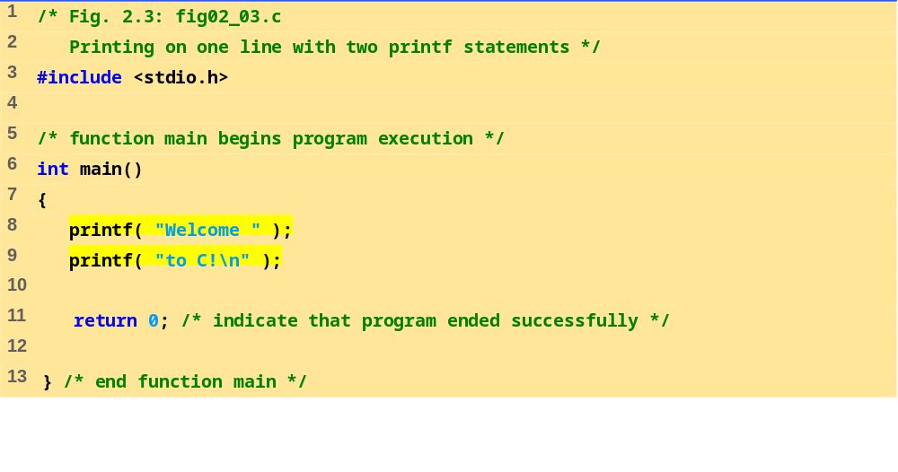
fig02_03.c
Program Output
Welcome to C!

Slide 10
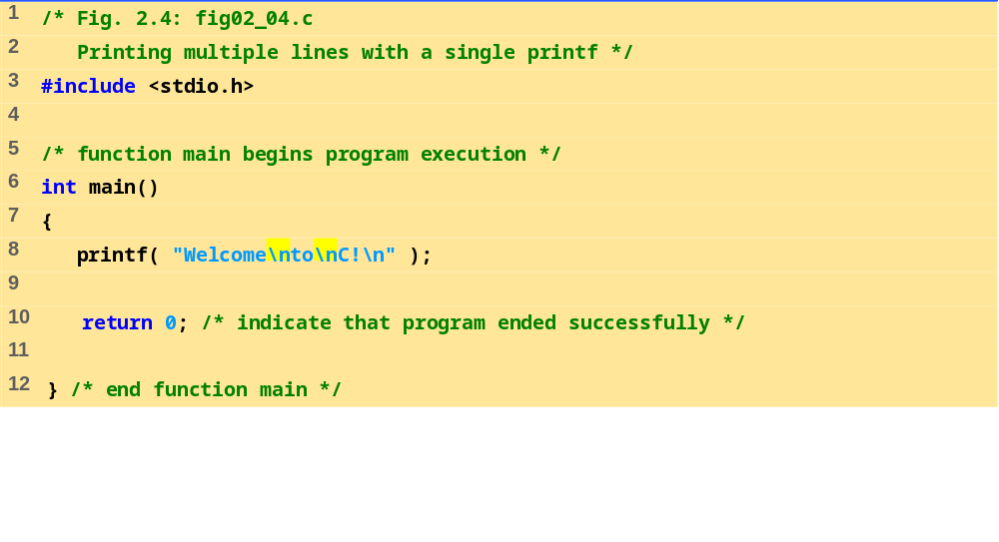
fig02_04.c
Program Output
Welcome
to
C!

Slide 11
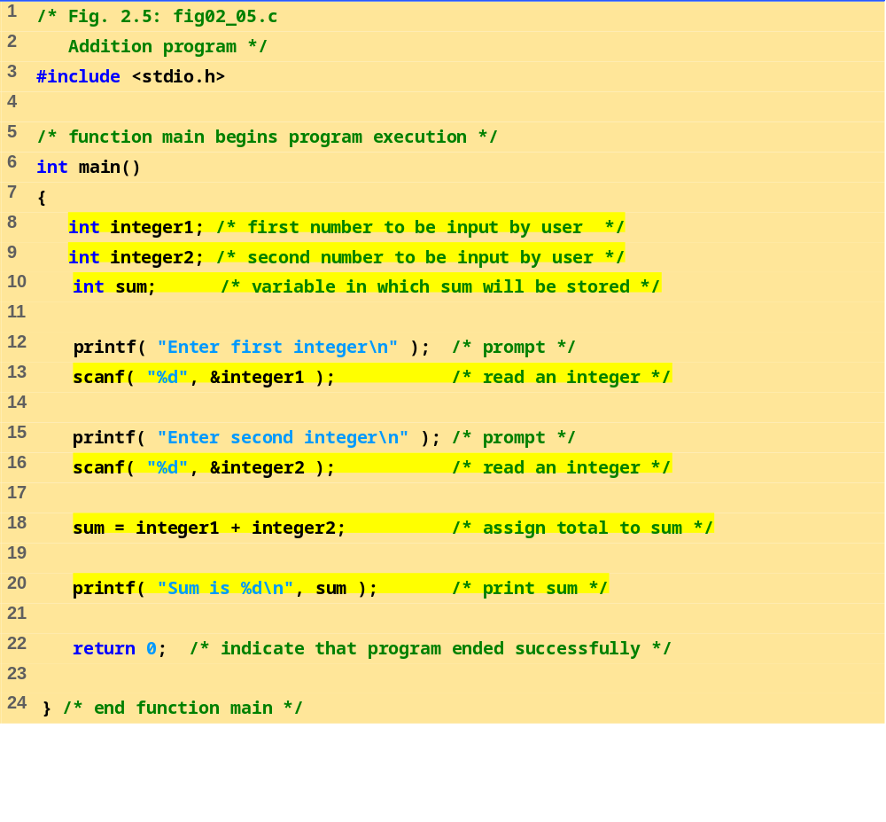
fig02_05.c

Slide 12
Program Output
Enter first integer
45
Enter second integer
72
Sum is 117

Slide 13
2.3 Another Simple C Program:
Adding Two Integers
As before
  Comments, #include <stdio.h> and main
int integer1, integer2, sum;
  Definition of variables
    Variables: locations in memory where a value can be stored
  int means the variables can hold integers (-1, 3, 0, 47)
  Variable names (identifiers)
    integer1, integer2, sum
    Identifiers: consist of letters, digits (cannot begin with a digit) and underscores( _ )
      Case sensitive
  Definitions appear before executable statements
    If an executable statement references and undeclared variable it will produce a syntax (compiler) error

Slide 14
2.3 Another Simple C Program:
Adding Two Integers
scanf( "%d", &integer1 );
  Obtains a value from the user
    scanf uses standard input (usually keyboard)
  This scanf statement has two arguments
    %d - indicates data should be a decimal integer
    &integer1 - location in memory to store variable
    & is confusing in beginning – for now, just remember to include it with the variable name in scanf statements
  When executing the program the user responds to the scanf statement by typing in a number, then pressing the enter (return) key

Slide 15
2.3 Another Simple C Program:
Adding Two Integers
= (assignment operator)
  Assigns a value to a variable
  Is a binary operator (has two operands)
    sum = variable1 + variable2;
    sum gets variable1 + variable2;
  Variable receiving value on left
printf( "Sum is %d\n", sum );
  Similar to scanf
    %d means decimal integer will be printed
    sum specifies what integer will be printed
  Calculations can be performed inside printf statements
    printf( "Sum is %d\n", integer1 + integer2 );

Slide 16
2.4 Memory Concepts
Variables
  Variable names correspond to locations in the computer's memory
  Every variable has a name, a type, a size and a value
  Whenever a new value is placed into a variable (through scanf, for example), it replaces (and destroys) the previous value
  Reading variables from memory does not change them
A visual representation
integer1
45

Slide 17
2.4 Memory Concepts
A visual representation (continued)
integer1
45
integer1
45
integer2
72
integer2
72
sum
117

Slide 18
2.5 Arithmetic
Arithmetic calculations
  Use * for multiplication and / for division
  Integer division truncates remainder
    7 / 5 evaluates to 1
  Modulus operator(%) returns the remainder
    7 % 5 evaluates to 2
Operator precedence
  Some arithmetic operators act before others (i.e., multiplication before addition)
    Use parenthesis when needed
  Example: Find the average of three variables a, b and c
    Do not use: a + b + c / 3
    Use: (a + b + c ) / 3

Slide 19
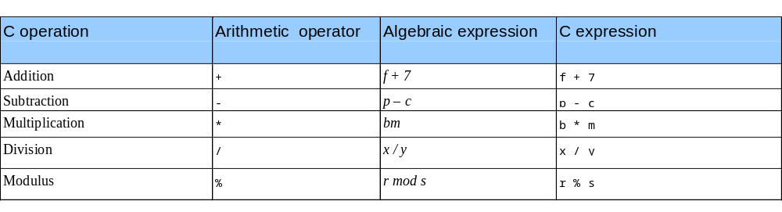
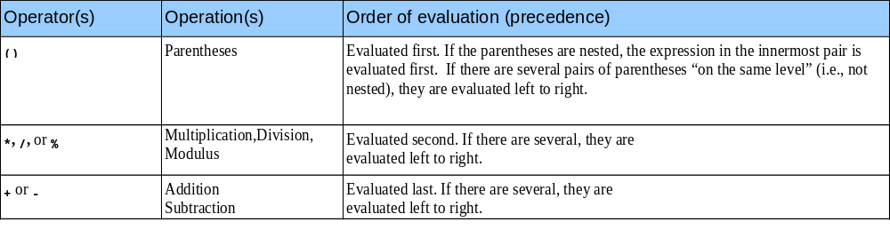
2.5 Arithmetic
Arithmetic operators:
Rules of operator precedence:

Slide 20
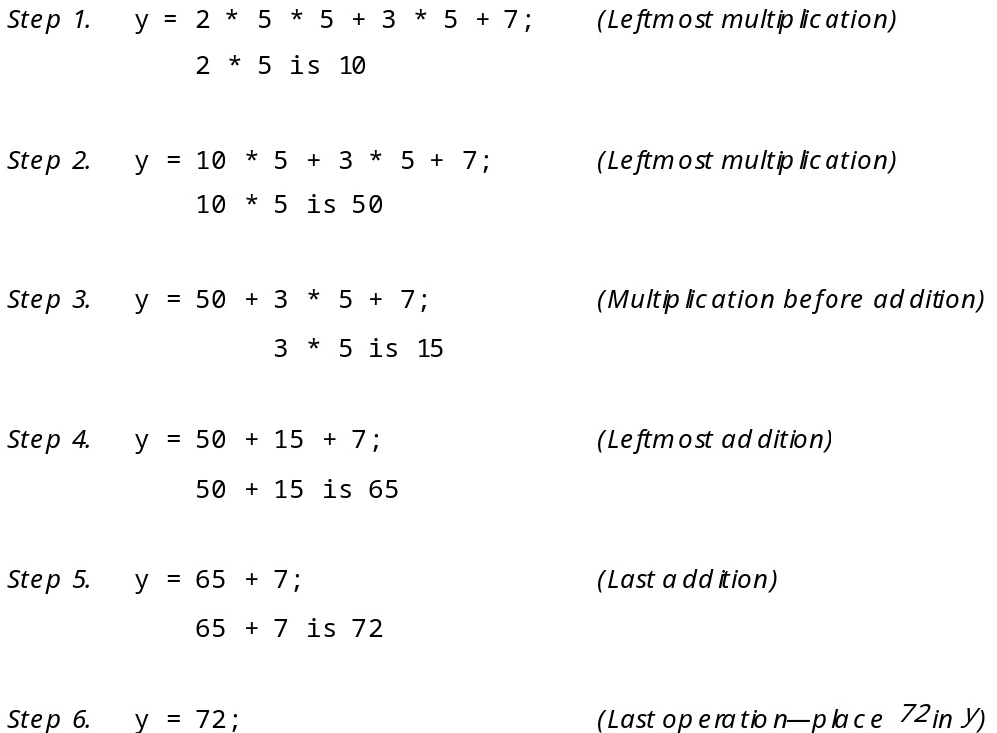
2.6 Decision Making: Equality and Relational Operators

Slide 21
2.6 Decision Making: Equality and Relational Operators
Executable statements
  Perform actions (calculations, input/output of data)
  Perform decisions
    May want to print "pass" or "fail" given the value of a test grade
if control statement
  Simple version in this section, more detail later
  If a condition is true, then the body of the if statement executed
    0 is false, non-zero is true
  Control always resumes after the if structure
Keywords
  Special words reserved for C
  Cannot be used as identifiers or variable names

Slide 22
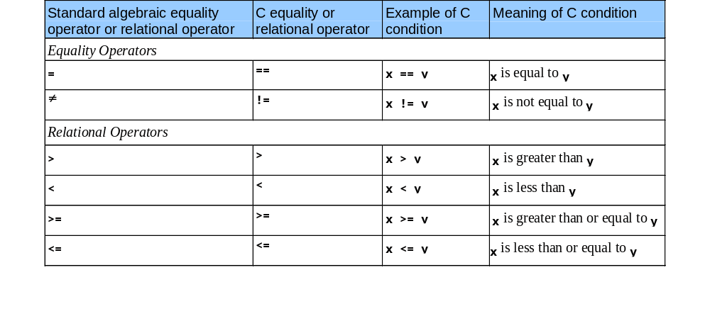
2.6 Decision Making: Equality and Relational Operators

Slide 23
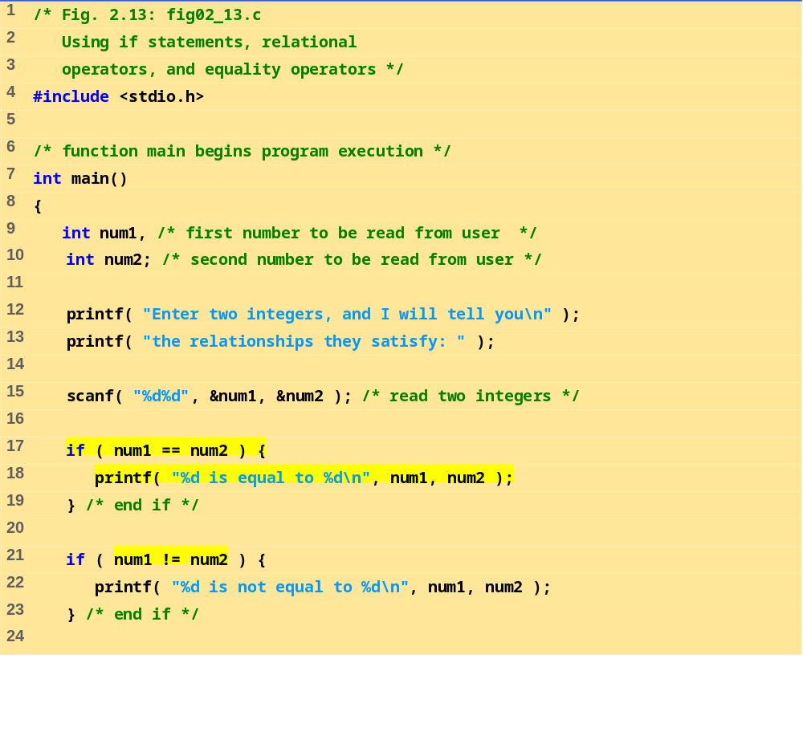
fig02_13.c (Part 1 of 2)

Slide 24
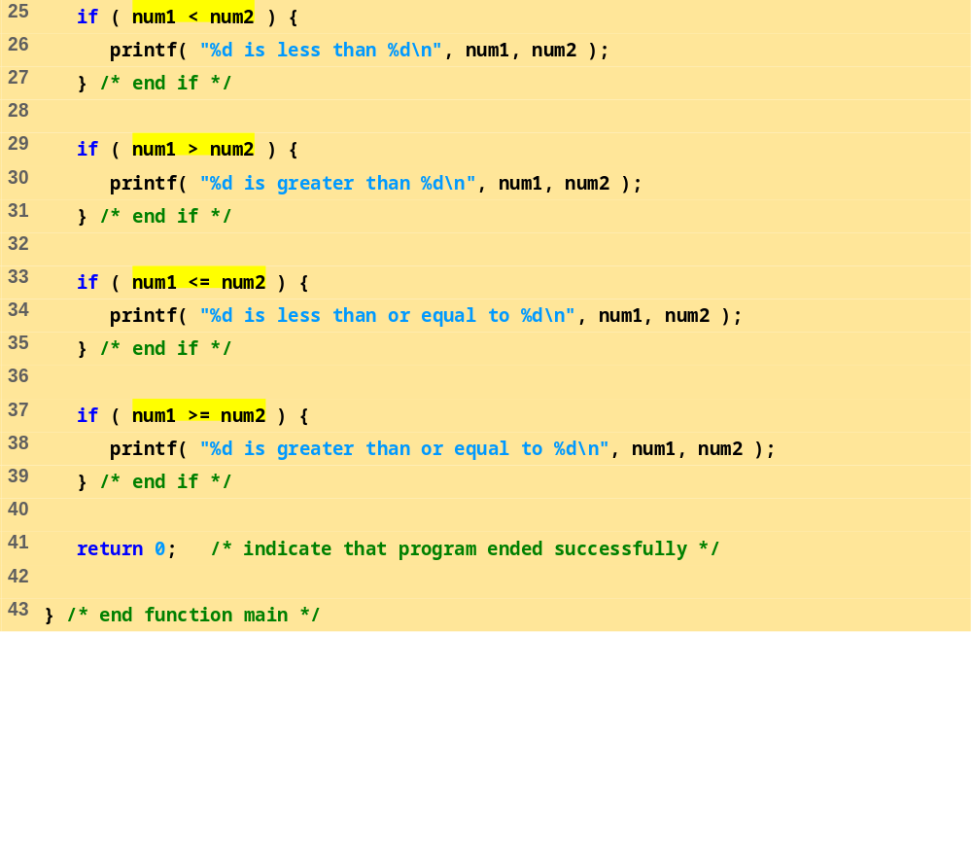
fig02_13.c (Part 2 of 2)
Program Output
Enter two integers, and I will tell you
the relationships they satisfy: 3 7
3 is not equal to 7
3 is less than 7
3 is less than or equal to 7

Slide 25
Program Output (continued)
Enter two integers, and I will tell you
the relationships they satisfy: 22 12
22 is not equal to 12
22 is greater than 12
22 is greater than or equal to 12
Enter two integers, and I will tell you
the relationships they satisfy: 7 7
7 is equal to 7
7 is less than or equal to 7
7 is greater than or equal to 7

Slide 26
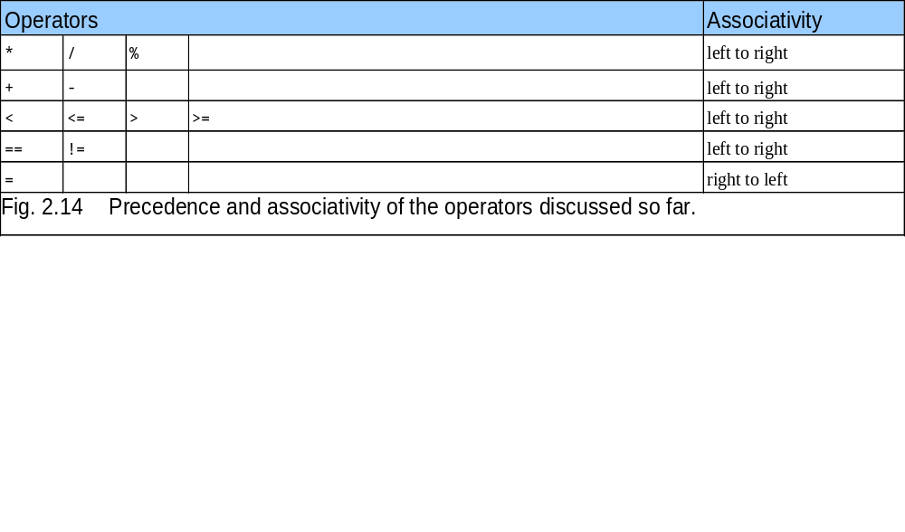
2.6 Decision Making: Equality and Relational Operators

Slide 27
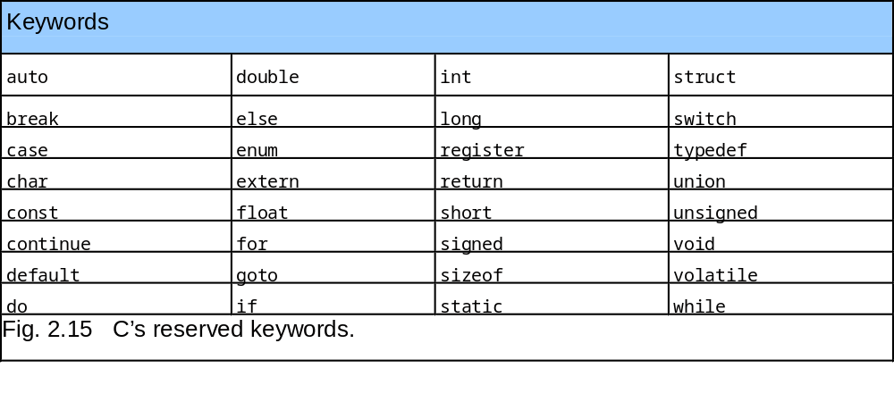
2.6 Decision Making: Equality and Relational Operators

